Slide 1
Be prepared webinar series
Be prepared for your academic studies at the University of Chichester

Slide 2
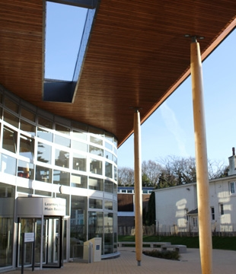
Welcome to the University of Chichester!
We hope to see you at our International Orientation on Sunday 22/09!

Slide 3
Getting ready for study at the University of Chichester
Sue Lavender
Head of International Programmes
S.Lavender@chi.ac.uk

Slide 4
During this session …
Please keep your camera on so we can see you!
Please turn your microphone on only when you need to speak
Raise your hand if you have a question
We are recording the session so you can view again later
Problems? Email: international@chi.ac.uk
We will send you a link to the session slides & video!

Slide 5
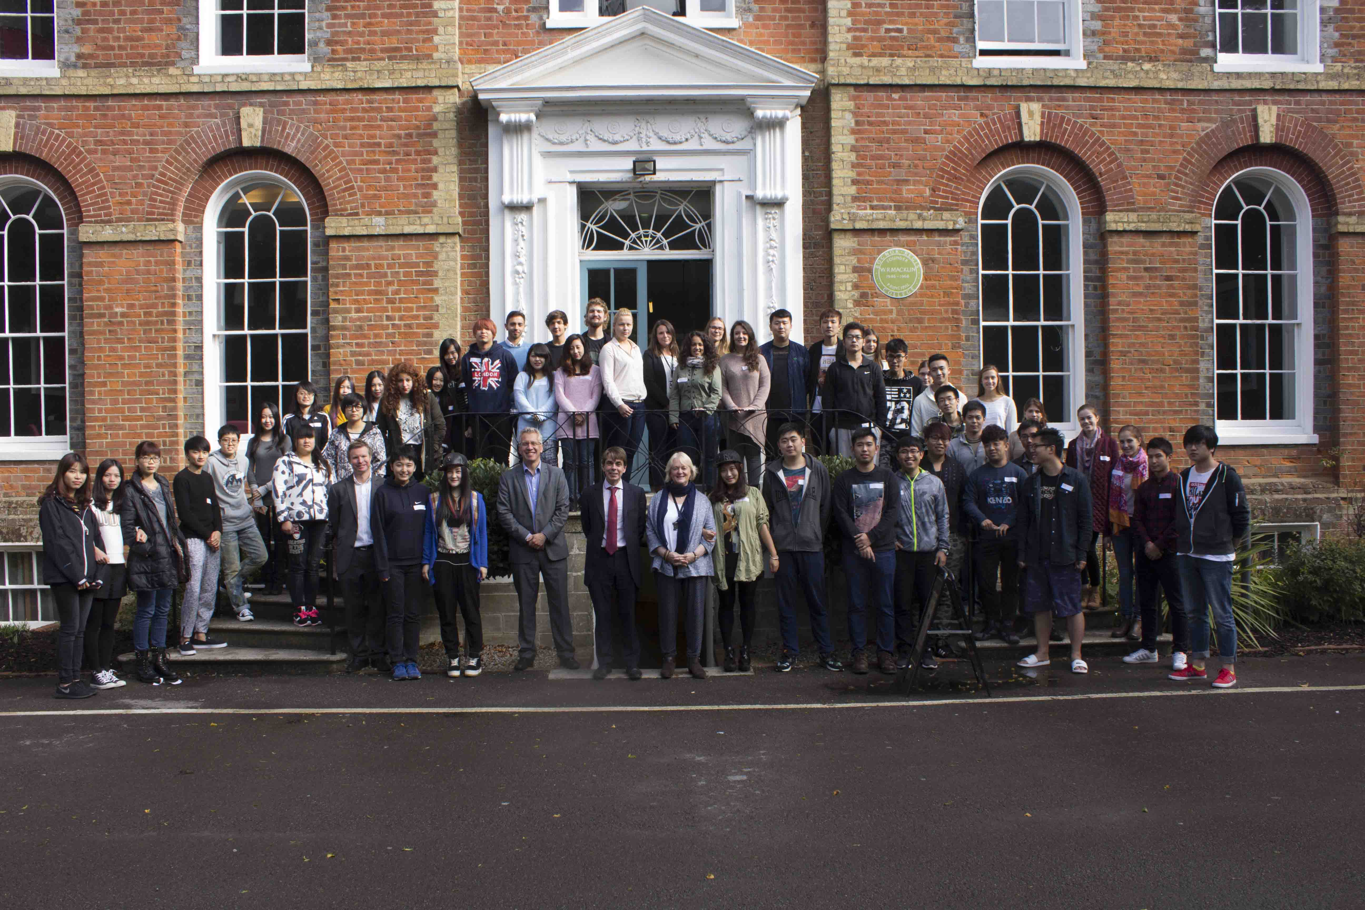
Welcome to the University of Chichester!
Consistently highly ranked for student satisfaction
A thriving international community

Slide 6
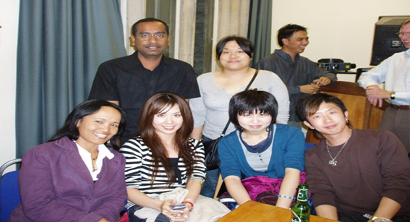
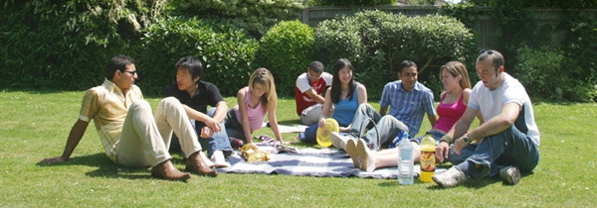
3 top reasons our international students enjoy Chichester
Excellent levels of support for international students
Small, friendly & interactive classes
Peaceful, attractive & safe campuses & locations

Slide 7
In this session ...
How to prepare for your Programme
Who to contact if you need help
Dates of your studies
How we communicate with you
How we structure our Programmes
Assessments
Language & academic culture support
Any questions?
If you have questions, please ask at any point!

Slide 8
Who are you?
Name
Where from
What studying
Do you have any questions now?

Slide 9
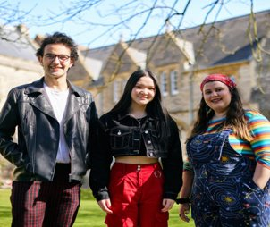
How to prepare for your Programme: 12 tips
Use the University website to read about your Programme & the University
Read about your subject in English
Follow all the registration advice
Arrive in the UK in time for the start of your Programme
Join social media groups
Surround yourself with English
Find out about the local area
Attend all induction events
Ask questions!
Don't worry!
Download the App
Expect differences from your home academic culture!

Slide 10
The University App
‘My UoC’ is available to download from Google and Apple mobile app stores
Latest News (University Website, UCSU, Wellbeing)
University Links (Email, Moodle, ChiView, etc)
Room Availability QR scanner
Support contact points
University Maps and Bus timetables
For more information and to download My UoC visit: help.chi.ac.uk/app

Slide 11
Programme Start Dates
International Orientation Sunday 22/09
Most programmes begin with an induction from 23/09
You will receive an email from your Programme Administrator with your start dates
International Welcome party Thursday 26/09

Slide 12
Where to go if you need help
Academic information on your Programme:
Programme Leader
Academic information on particular Modules:
Module tutors: see your Moodle pages
Administrative information on your Programme:
Programme Administrators
Welfare or external information (including visas):
International Student Adviser (Paivi) international@chi.ac.uk
Advice on your personal progress/support with your English: Academic Adviser/IALs tutor
Accommodation: allocations@chi.ac.uk
Anything else + IT support:
SIZ help@chi.ac.uk

Slide 13
How we keep in touch with you
ChiView
Moodle pages
University email
We address each other by 'first' names
Please complete your online registration as soon as you can!

Slide 14
2 campuses
BOC = Bishop Otter Campus (Chichester)
BRC = Bognor Regis Campus
Free intercampus bus service

Slide 15
Some key information
You should expect to be in class for about 12 hours each week
You should expect to study for about 36 hours each week
Your timetable will be the same each week of the semester
You will be able to view your timetable via Moodle & ChiView
Our classes are small and interactive so you need to take part
You must attend all your classes (we monitor attendance electronically)
You will normally have one class each week for each module

Slide 16
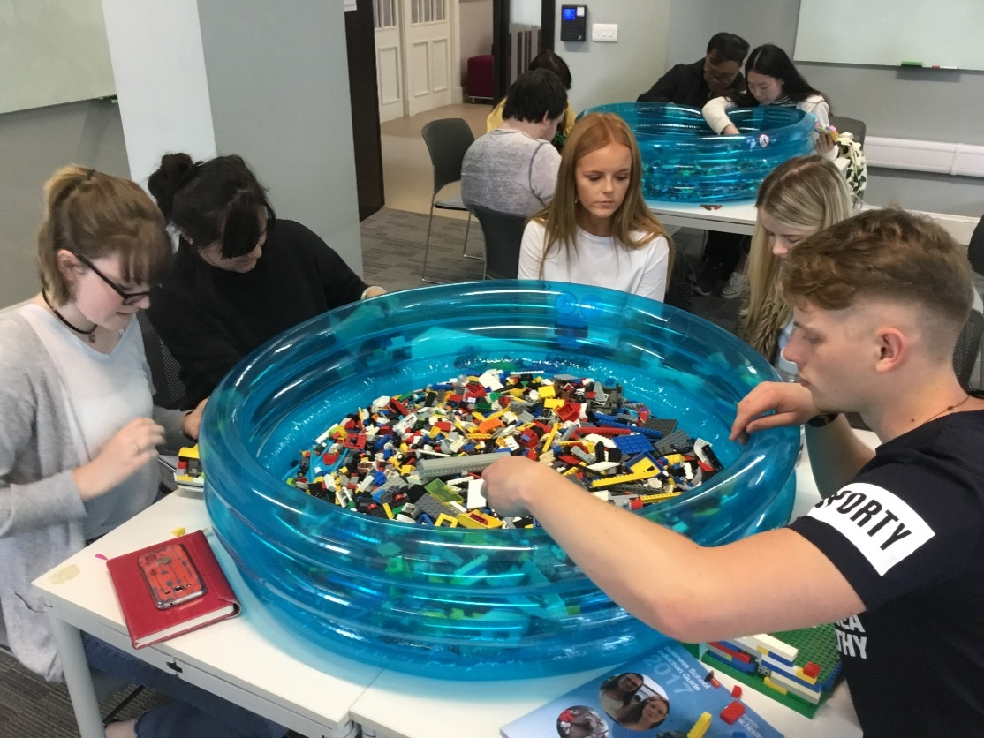
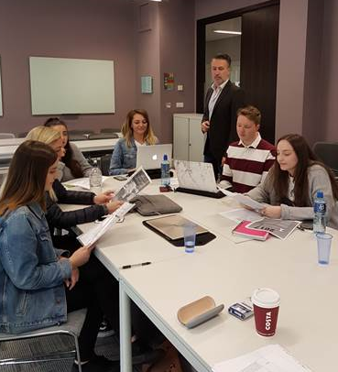
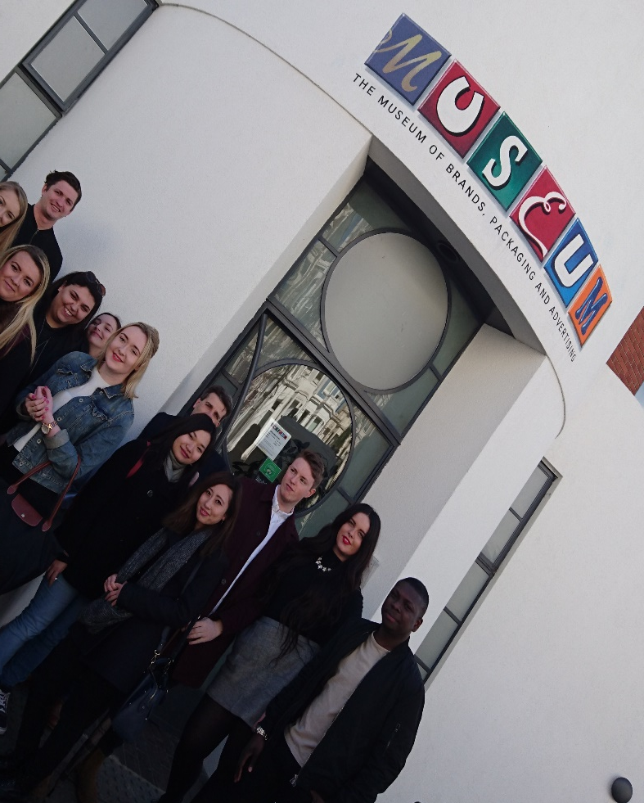
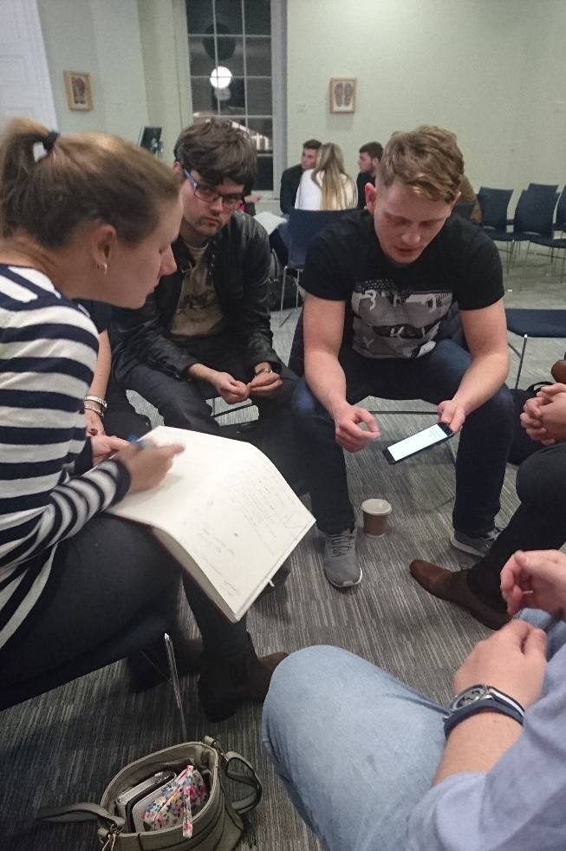
INDUCTION
Creative learning
Guest speaker event
Marketing Forum
Masterclasses
Field trip
Notes:
Image round up of session types an activities

Slide 17
International academic & language support (IALs)
Available at no extra charge to all international students (if English is not your first/main working language & if language development is not a part of your programme)
Individual tutorial support with language elements of coursework (6 hours per year)
Use of extra time & bilingual dictionaries in examinations
Optional weekly classes in Academic Language & Skills and English Language Discussion
A dedicated web-based resource for international students
Advice about study in another academic culture
Complete your online registration!

Slide 18
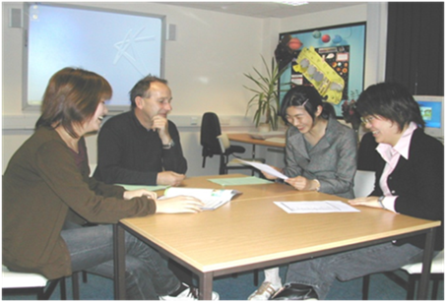
Assessment
You are assessed at the end of each module
See your Module Moodle page for details
Essay
Report
Project
Examination (unseen & seen)
Presentation
Practical performance
Portfolio
Dissertation
You can be reassessed once in each module for a capped mark

Slide 19
The UK University undergraduate mark scheme
70%+ excellent
60%+ good & average
50%+ acceptable
40%+ weak pass
- 40% fail
Please note: work which is not your own (including use of AI) must always be credited!

Slide 20
The UK University postgraduate mark scheme
70%+ distinction
60%+ merit
50%+ acceptable
- 50% fail
Please note: work which is not your own must always be credited!

Slide 21
City of Chichester

Slide 22
Bognor Regis

Slide 23
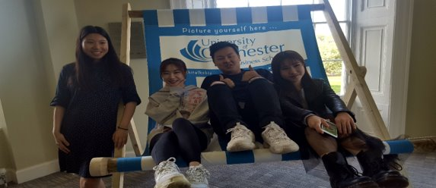
We look forward to meeting you in person very soon!
If you have questions please email: international@chi.ac.uk

